Slide 1
Monitoring and Controlling Risk: Course Wrap Up
Module 6

Slide 2
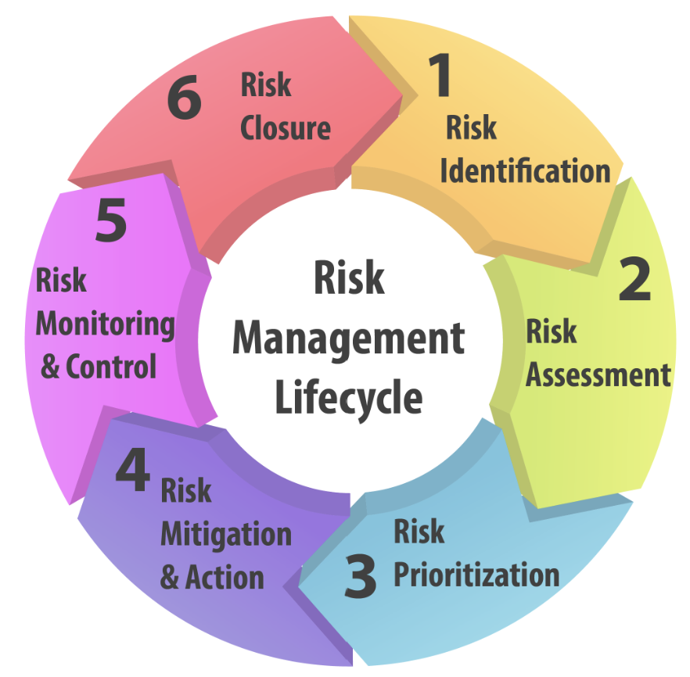
Objectives
Control risks throughout the risk management life cycle
Summarize the risk management process
How risk management applies to data analytics

Slide 3

Risk Control
Detective Risk Control:
Preventative Risk Control
Corrective Risk Control

Slide 4

Steps for a Risk Control
Timely analysis of the current business activities to identify potential risks.
Mitigating actions to either reduce or eliminate risks.
Re-assess the business activities to ensure the successful implementation of the measures.

Slide 5

Risk Control Techniques
Avoidance: to avert a risk entirely
Loss Prevention: accepts the risk and prevents expected losses.
Loss Reduction: accepts both the risk and the loss

Slide 6
Risk Control Techniques
Separation: spreading of key assets
Duplication: creation of a backup plan.
Diversification

Slide 7

Role of Data Analyst
Understand how risk management plays a part within data analytics
Understand how to escalate risk to the proper person within the organization\
Identify risks within the data analysis and communicating those risks
Support the risk assessment process to:
provide guidance on how critical the risk could be to data management
ensure data analysis is not disrupted by an issue that could have been identified as a risk

